Slide 1


Myntra
Analysis

Slide 2


Overview And Journey of Myntra
Myntra: Journey to Leadership in Online Fashion
Founded: 2007 by Mukesh Bansal, Ashutosh Lawania, and Vineet Saxena as a personalized gifting platform.
Pivot to Fashion: Shifted focus to online fashion and lifestyle in 2011, partnering with top Indian and global brands.
Innovations: Introduced private labels, AI-driven recommendations, easy returns, and app-only shopping (2015).
Marketing & Growth: Gained traction through digital marketing, exclusive collections, and flagship events like the "End of Reason Sale" (EORS).
Current Status: Operates as a Flipkart subsidiary (acquired in 2014), under Walmart’s ecosystem, leveraging resources to maintain market leadership.

Slide 3



OUR MISSION
OUR VISION
Myntra’s mission is to "make fashion and lifestyle accessible, engaging, and fun for everyone, while offering a seamless and personalized shopping experience."
Myntra’s vision is to "be the most customer-centric and trusted fashion destination in India, leading the industry through innovation, sustainability, and strong partnerships with brands and sellers."
These statements align with Myntra's focus on delivering exceptional value to customers, embracing technology-driven solutions, and shaping the future of fashion and lifestyle retail.

Slide 4
Core Values
Customer Centercity
Innovation
Intergrity
Technology
Constantly seeking new ways to enhance the shopping experience.
Upholding honesty, transparency, and ethical practices in all our interactions.
Working together as a team to achieve common goals
Putting the customer at the heart of everything we do.

Slide 5

Business Model Of Myntra
Core Model: Primarily B2C, selling fashion, accessories, and beauty products directly to consumers.
Marketplace Integration: Hosts third-party vendors, expanding product variety without holding full inventory.
Exclusive Collaborations: Offers unique collections via partnerships with domestic and international brands.
Logistics Excellence: Ensures fast, reliable deliveries through a robust supply chain.
Tech-Driven Personalization: Leverages AI and data analytics for tailored product recommendations, enhancing customer experience.

Slide 6
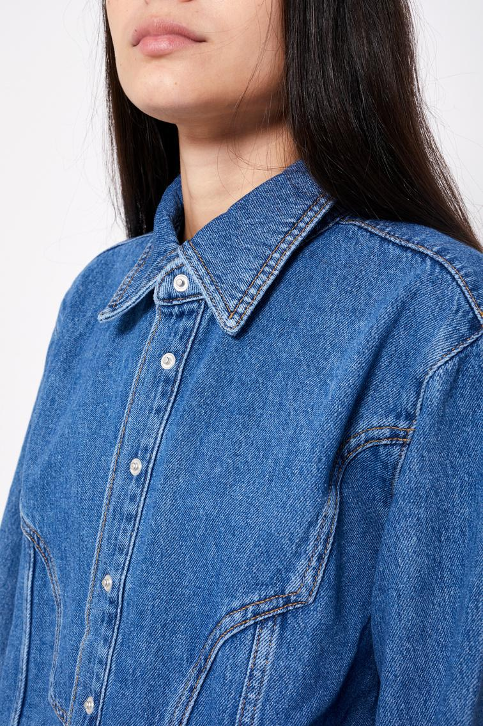

MARKET POSISTION AND GROWTH
Market Position :
Myntra is a leading player in the Indian online fashion retail industry, holding a dominant position with a strong focus on fashion and lifestyle products. It is one of the largest and most popular e-commerce platforms in India for apparel and accessories Myntra faces competition from major players like Flipkart, Amazon Fashion, Ajio, and Tata CLiQ in the online fashion space.
While Flipkart and Amazon dominate overall e-commerce, Flipkart's fashion segment is Myntra's biggest competitor.
Growth Trajectory:
Myntra has experienced significant growth, expanding its customer base and product offerings. The platform has continuously improved its technology, logistics, and exclusive brand collaborations. Myntra’s acquisition by Flipkart helped fuel its growth, positioning it as a leader in online fashion retail in India.
Myntra has seen consistent growth, expanding its product portfolio, increasing user base, and leveraging its technology-driven strategies. The platform's exclusive collaborations and increased customer loyalty programs have boosted its reach and sales.

Slide 7
REVENUE MODEL2023-2024 BREAK DOWN
Key Financial Highlights :
Total Operating Revenue: ₹5,121.8 crore
Growth: 14.71% increase from ₹4,465 crore in FY 2022-23
2
3
1
Advertising Services:
Revenue: ₹712.3 crore
Contribution: 13.9% of operating revenue
Logistics Services:
Revenue: ₹2,439 crore
Contribution: 47.6% of operating revenue
Marketplace Services:
Revenue: ₹1,774.6 crore
Contribution: 34.6% of operating revenue
PRODUCT SALES REVENUE:
Revenue from Logistics + Marketplace: ₹4,213.6 crore
Contribution to Total Revenue: 82.2%
PROFITABILITY: MYNTRA ACHIEVED A NET PROFIT OF ₹31 CRORE IN FY24, A TURNAROUND FROM A LOSS OF ₹782 CRORE IN FY23

Slide 8


TECHNOLOGY UTILIZATION OF MYNTRA
Cloud Service Provider: Myntra has migrated its entire tech portfolio to Microsoft Azure to enhance scalability and operational efficiency.
Key Azure Services:Azure Synapse Analytics: Used for big data analytics and integrating data from various sources
Azure HDInsight: Facilitates processing large amounts of data using open-source frameworks like Hadoop and Spark.

Slide 9


DATA STORAGE SOLUTIONS
The integration of Microsoft Power BI allows real-time data visualization and decision-making based on customer feedback.
Myntra utilizes Azure's cloud storage capabilities to centralize its data platform, enabling advanced analytics and machine learning applications.

Slide 10


BENEFITS OF CLOUD MIGRATION
Improved ability to handle seasonal spikes in traffic (e.g.,
over 7,000 orders per minute during peak sales).
Enhanced customer experience through personalized recommendations and marketing strategies powered by AI and machine learning
Partnership with Microsoft: Myntra's collaboration with Microsoft since 2018 has been pivotal in its digital transformation, focusing on innovation, speed, and agility.
Cost Efficiency: Myntra has also explored AWS for public cloud solutions, achieving significant cost savings while maintaining flexibility in scaling resources as needed.

Slide 11


IMPACT OF TECHNOLOGY
1. Personalized Experiences
AI Tools: MyFashionGPT, MyStylist, and AI Skin Analyzer provide tailored fashion and skincare advice, boosting engagement and conversions.
Virtual Try-On: Increases product consideration by 1.5x and reduces return rates by enabling product visualization.
2. Operational Excellence
Omnichannel Strategy: Faster deliveries via local stores improve convenience.
Data Analytics: Optimizes inventory, logistics, and order fulfillment.
3. Enhanced Engagement
Social Commerce: Features like MLive drive user interaction and impulse purchases.
Mobile Optimization: Seamless app design increases monthly active users.
4. Marketing & Loyalty
Influencer Marketing: Strengthens brand visibility and customer loyalty.
Loyalty Programs: Myntra Insider rewards frequent shoppers with exclusive benefits.

Slide 12


CUSTOMER ANALYSIS OF MYNTRA
Positive Reviews
Express Delivery: Many customers appreciate Myntra's express delivery service, noting that they received their orders within 24-48 hours.
Wide Selection: Customers enjoy the extensive range of products available, with over 1.7 million styles from numerous brands.
User Experience: Positive feedback regarding the app's user interface and the ease of navigating through products.
Customer Support: Some users have praised the customer service for effectively resolving queries and issues.
Negative Reviews
Product Quality Issues: Several customers reported receiving low-quality items that did not match their expectations or descriptions.
Return Process Problems: Many expressed frustration with the return process, citing difficulties in getting approvals or receiving refunds.
Review Approval Issues: Users noted that their negative reviews were not approved on Myntra's platform, leading to concerns about transparency and authenticity.
Misleading Product Descriptions: Complaints about receiving incorrect items or products that were misrepresented (e.g., wrong fit or brand).
Medium Reviews
Mixed Experiences: Some customers had both positive and negative experiences, such as enjoying the product selection but facing challenges with delivery times or customer service responsiveness.
Sustainability Efforts: Acknowledgment of Myntra's efforts towards sustainability was noted positively by some customers, although others felt that more could be done.

Slide 13


Brand Perception Analysis of Myntra
Positive Perceptions
Wide Product Range: Extensive selection of brands and styles.
Discounts & Offers: Attractive promotions enhance shopping appeal.
User-Friendly Interface: App/website praised for smooth navigation.
Fast Delivery: Many report prompt order deliveries.
Return Policy: Favorable return/refund options.
Negative Perceptions
Customer Service: Unresponsive support, unresolved complaints.
Quality Issues: Products often fail to meet expectations.
Review Concerns: Non-approval of negative reviews affects transparency.
Delivery Delays: Common complaints about late deliveries.
Inconsistent Quality: Incorrect/inferior items impact trust.
Mixed Perceptions
Sustainability: Some initiatives praised; more efforts expected.
Feedback Engagement: Mixed views on responsiveness to feedback.

Slide 14



MARKET TRENDS FOR MYNTRA
Gen Z Trends (18-25)
Bold Styles: Quirky prints, vibrant accessories, streetwear, oversized blazers.
Fast Fashion: Demand for quickly updated collections and daily deals.
Social Media Influence: Fashion inspired by Instagram/TikTok content.
Sustainability: Rising interest in eco-friendly options.
Millennial Trends (26-40)
Classic Modern Styles: Timeless pieces with versatility and durability.
Comfortable Fashion: Stylish loungewear and athleisure for remote work.
Accessory Focus: Investments in statement bags, shoes, and add-ons.
General Trends
Sneakers & Casual Wear: Retro sneakers leading sales.
Diverse Range: Ethnic and contemporary fashion for all age groups.
Influencer Collaborations: Boosting engagement across demographics.
City-Specific Trends
Bengaluru: High demand for dresses.
Pune: Popularity of casual T-shirts.
Hyderabad: Preference for traditional kurta sets.
Chennai: Blend of traditional and modern styles.

Slide 15
Comparison of Myntra with Key Competitors: Amazon Fashion, Flipkart, and AJIO
Feature | Myntra | Amazon Fashion | Flipkart | AJIO
Customer Satisfaction | Generally positive; issues with service quality | Excellent service; some quality issues | Competitive pricing; service complaints | Rising satisfaction; focus on quality
Product Range | Extensive fashion focus; strong ethnic wear | Vast categories; less focused on fashion | Diverse categories; robust fashion segment | Curated fashion collections; trendy styles
Market Presence | Over 50% share in fashion; strong social media engagement | Lower fashion share; benefits from overall brand recognition | 48% overall e-commerce share; diverse offerings | Approximately 30% MAU market share; innovative marketing

Slide 16


ACTIONABLE STRATEGIES FOR MYNTRA
1.Enhance Customer Experience
Customer Support: Faster response times, personalized support, and clear escalation protocols.
Refunds/Returns: Streamlined processes, faster refunds (3-5 days), and real-time tracking.
Product Quality: Stricter quality checks and detailed product descriptions.
2. Leverage Technology
AI Recommendations: Personalized product suggestions.
AR Features: Virtual try-ons to boost purchase confidence.
3. Expand Market Reach
Curated Collections: Targeted styles for Gen Z and Millennials.
Localized Campaigns: Regional influencers and language-specific ads for Tier 2/3 cities.
Sustainability: Eco-friendly product lines and sustainable packaging.
4. Build Trust and Engagement
Verified Reviews: Highlight authentic customer feedback.
Loyalty Programs: Exclusive benefits, rewards for recycling, and gamified experiences.
Influencer Marketing: Partner with relatable figures for credibility.
5. Innovate and Monitor Trends
Competitor Benchmarking: Analyze pricing and features.
New Features: "Snap & Shop" visual search and live shopping events.
Feedback Loops: Regular NPS surveys and real-time issue resolution.

